Slide 1
KK AUTOINDUSTRIES
Manufacturer of Sheet metal , Forging, Turning Components and Tool kit bag for Automobile

Slide 2
Location/ Address
PLOT NO. 14 , K.S. COMPLEX
NEAR CHD. ROAD
NICHI MANGLI , LUDHIANA
MOBILE 9872412399

Slide 3
COMPANY PROFILE
The kk auto industries was established in the year 2012 .Since, then company has grown steadily in size and capability.
The business area involved manufacturing of sheet metal pressing, turning , forging components and tool kit bag for wide spectrum of industry including Automobile( 2 –Wheeler, Passengers Cars, Lcv & Trucks )

Slide 4
OUR BELIEF
In the present time of uncertainty and instability the speed and agility with which a co- operation responds to change is an important factor in determining its ability to succeed.

Slide 5
POLICY
To satisfy customer by providing good quality products first time and every time by continuous improvement in quality.

Slide 6
Our Products
KK auto industries has the capability to supply sheet metal, forging components and Tool kit bag.

Slide 7
TOOL KIT BAGS
TOOL KIT BAG FOR MARUTI
TOOL KIT BAG FOR HONDA
TOOL KIT BAG FOR KIA

Slide 8
TOOL KIT BAG HONDA

Slide 9
TOOL KIT BAG HONDA

Slide 10
Forging Components
Wheel Wrench
Bar jack Handle
Extension jack handle

Slide 11
Wheel Wrenches

Slide 12
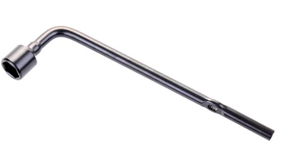
Wheel Wrenches

Slide 13
( Wheel Wrench 19)

Slide 14
Handle Extension jack Handle

Slide 15
Z bending Handle Maruti

Slide 16
Handle for kia motors

